Slide 1
Competing risks event history analysis- examples using STATA
Dr. Bernice Kuang
Full resource, see: https://www.ncrm.ac.uk/resources/online/all/?id=20861

Slide 2
What if there is an event that competes with the event of interest?
Event of interest – marriage
Competing event – breakup
The risk of a breakup “competes” with the risk of marriage – one event must happen first
Risk of events (i.e. marriage) begins when the partnership begins
Exit from risk set when event is experienced OR subject no longer at risk (i.e. death of partner), OR the observation period ends (at time of interview)

Slide 3
Derive outcome and event time variables
Derive a variable describing the analysis time for each subject duration
  duration is the duration from time at entry into risk set to event time or time of censoring
Expand the duration variable into 1 row per unit of time. For example, someone who has 3 years of analysis time, from time of partnership formation to marriage, will end up with 3 rows of data with 1 row representing each year for that person
This reshapes the dataset into a person-period file
Find the person year where the event occurred and label it

Slide 4
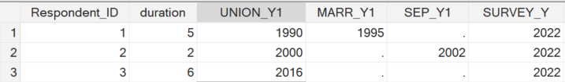
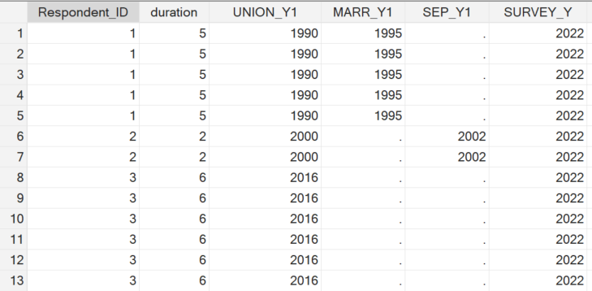
Expand dataset into person-time format
expand duration
Each row in the dataset is
one person
Each row in the dataset
now represents one year
in one person’s life

Slide 5
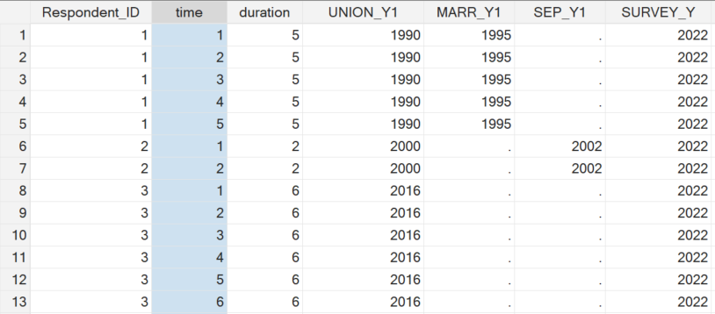
Person-time datafile
Label each person-year (i.e., year 1, year 2, year 3)
bysort RESPONDENT_ID: gen time=_n

Slide 6
When did the event happen?
Flag the person-year that the event occurred in
  This year should be the person-year that is the FINAL year in the duration from partnership entry till the end of analysis time
gen y=cohabitation
replace y=“marriage” if time==duration & MARR_1==1)
replace y=“separation” if time ==duration & SEP_1==1)

Slide 7
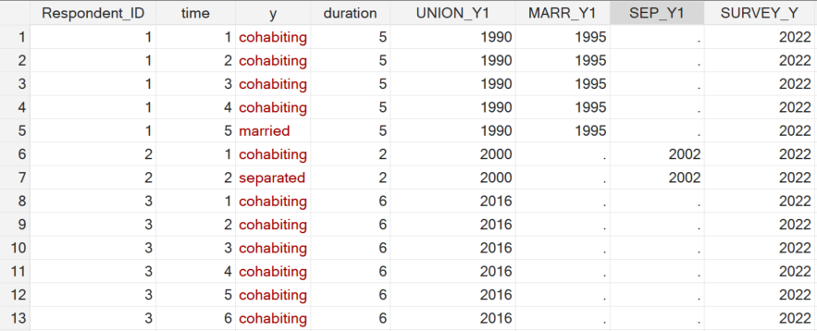
Partnership status in each year

Slide 8
What about those who had no event?
These people should have all person years labelled “cohabitation” because they do not experience an event within analysis time

Slide 9
Multinomial logistic regression
mlogit y time i.EDU_3 c.startage_y, rrr
The analytic sample is the whole person-time
file – the unit is each row
There are three possible outcomes
  Marriage
  Separation
  Remain in cohabitation (base outcome)
Output shows the relationship between
odds of outcome and covariates

Slide 10
Multinomial logistic regression
mlogit y time i.EDU_3 c.startage_y, rrr
Starting the relationship at an older age
increases the odds of marriage by 2.7%
for each additional year older
Being less educated decreases the odds
of marriage
  20% for medium versus highly educated people
  44% for low versus highly educated people

Slide 11
www.ncrm.ac.uk

